Slide 1
Decision Support System
- A system for decision making and problem solving.
-A system for decision making and problem solving.

Slide 2




What is DSS?
A DSS is a computer-based information system that supports business or organizational decision-making activities.
A DSS is a collection of integrated software applications and hardware that form the backbone of an organization’s decision making process and help to make decisions, which may be rapidly changing and not easily specified in advance.

Slide 3




Decision Making as a Component of Problem Solving
Intelligence
Decision making
Design
Choice
Problem
solving
Implementation
Monitoring

Slide 4
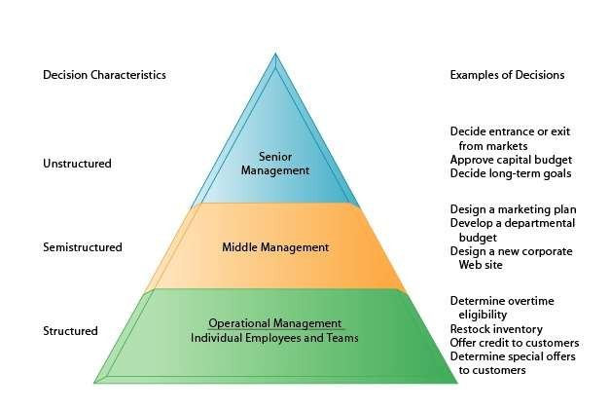
TYPES OF DECISION

Slide 5
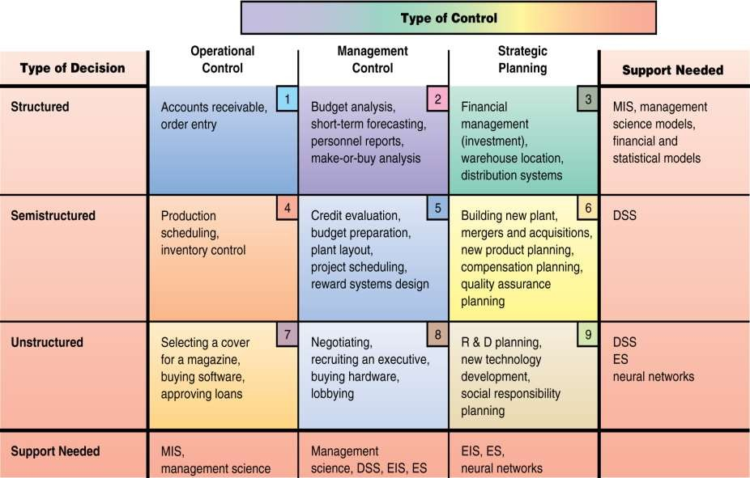
DECISION MAKING CONCEPTS

Slide 6







FRAMEWORK FOR DEVELOPING DSS
Examination
Validation of the Model
REALITY
☹
Intelligence Phase
Design Phase
Verification, Testing of Proposed Solution
☺
SUCCESS
Choice Phase
Implementation of Solution
FAILURE ☹

Slide 7
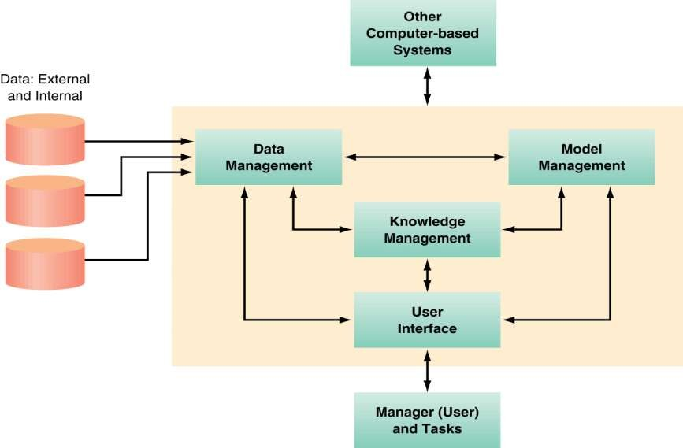
COMPONENTS AND STRUTURE OF DSS

Slide 8
COMPONENTS AND STRUTURE OF DSS (Continue..)
Data Management
Includes the database(s) containing relevant data for the decision
situation
User Interface
Enables the users to communicate with and command the DSS
Model Management
Includes software with financial, statistical, management science, or other quantitative models
Knowledge Management
Provides knowledge for solution of the problem; supports any of the other subsystems or act as an independent component

Slide 9
DSS – CLASSIFICATIONS -RELATIONSHIP WITH THE USER
Passive DSS
System that aids the process of decision making, but that cannot bring out explicit decision suggestions or solutions.
Active DSS
Can bring out such decision suggestions or solutions.
Cooperative DSS
Allows the decision maker to modify, complete, or refine the decision suggestions provided by the system, before sending them back to the system for validation. The system again improves, completes, and refines the suggestions of the decision maker. Repeat this process.

Slide 10
DSS- Classifications –Mode of Assistance
Model-driven DSS
Use data and parameters provided by users to assist decision makers in analyzing a situation
Eg :- Dicodess is an example of an open source model-driven DSS generator .
Communication-driven DSS
Supports more than one person working on a shared task
Eg:- Microsoft's NetMeeting or Groove
Data-driven DSS
Emphasizes access to and manipulation of a time series of internal company data and, sometimes, external data.

Slide 11
DSS- Classifications –Mode of Assistance (Continue…)
Document-driven DSS
Manages, retrieves and manipulates unstructured information in a variety of electronic formats.
Knowledge-driven DSS
Provides specialized problem solving expertise stored as facts, rules, procedures

Slide 12

D s s Characteristics :
Facilitation : DSS facilitate and support specific decision- making activities and/or decision processes.
Interaction : DSS are computer-based systems designed for interactive use by decision makers or staff users who control the sequence of interaction and the operations performed.
Ancillary : DSS can support decision makers at any level in an organization. They are NOT intended to replace decision makers.
Repeated Use : DSS are intended for repeated use. A specific DSS may be used routinely or used as needed for ad hoc decision support tasks.
Identifiable : DSS may be independent systems that collect or replicate data from other information systems OR subsystems of a larger, more integrated information system.

Slide 13

D S S Characteristics (cont.):
Task-oriented : DSS provide specific capabilities that support one or more tasks related to decision-making, including: intelligence and data analysis; identification and design of alternatives; choice among alternatives; and decision implementation.
Decision Impact : DSS are intended to improve the accuracy, timeliness, quality and overall effectiveness of a specific decision or a set of related decisions.
Supports individual and group decision making : It provides a single platform that allows all users to access the same information and access the same version of truth, while providing autonomy to individual users and development groups to design reporting content locally.
Comprehensive Data Access : It allows users to access data from different sources concurrently, leaving organizations the freedom to choose the data warehouse that best suits their unique requirements and preferences.

Slide 14

D S S Characteristics (cont.):
Easy to Develop and Deploy : DSS delivers an interactive, scalable platform for rapidly developing and deploying projects. Multiple projects can be created within a single shared metadata. Within each project, development teams create a wide variety of re-usable metadata objects.
Integrated software : DSS’s integrated platform enables administrators and IT professionals to develop data models, perform sophisticated analysis, generate analytical reports, and deliver these reports to end users via different channels (Web, email, file, print and mobile devices).
Flexibility : DSS features are flexible and can be altered according to need providing a helping hand in the work process.

Slide 15

D S S Objectives :
Increase the effectiveness of the manager's decision- making process.
Supports the manager in the decision-making process but does not replace it.
Improve the directors effectiveness of decision making.

Slide 16

D S S Components :
DSS components may be classified as:
Inputs : Factors, numbers, and characteristics to analyze.
User Knowledge and Expertise : Inputs requiring manual analysis by the user.
Outputs : Transformed data from which DSS "decisions" are generated.
Decisions : Results generated by the DSS based on user criteria.

Slide 17

D S S Requirements :
Data collection from multiple sources (sales data, inventory data, supplier data, market research data. etc.).
Data formatting and collation.
A suitable database location and format built for decision support -based reporting and analysis .
Robust tools and applications to report, monitor, and analyze the data.

Slide 18

D S S Advantages :
Time savings
Enhance effectiveness
Improve interpersonal communication
Competitive advantage
Cost reduction
Increase decision maker satisfaction
Promote learning
Improves personal efficiency

Slide 19

D S S Disadvantages :
Monetary cost.
Overemphasize decision making.
Assumption of relevance.
Transfer of power.
Unanticipated effects.
Obscuring responsibility.
False belief in objectivity.
Status reduction.
Information overload.

Slide 20

D S S Applications :
Medical diagnosis.
Business and Management.
Agricultural production.
Forest management.

Slide 21
Tools of DSS
Material Requirement Planning (MRP) is method for ordering and maintaining materials stocks cost effectively.
Linear Programming: PERT, CPM
Queuing Theory
Descriptive statistics
Correlation analysis
Variance analysis
Network analysis
Transportation problems
Maximum flow or distance
Regression analysis
Multi dimensional scaling
Dynamic programming
Probability theory

Slide 22
Example of DSS in Accounting system
Budgeting models
Cost analysis model
Break even analysis
Evaluation of funds and investment
Cash and funds flow model for budegting

Slide 23
Thank You

